Slide 1
Netflix Application Deployment
Project by Yashwanth Naidu

Slide 2
Project Overview
This project involves deploying the Netflix application across multiple phases.
Local deployment on EC2 instances.
Implementing security with SonarQube and Trivy.
Automating deployment with Jenkins.
Monitoring via Prometheus and Grafana.
Deployment using Kubernetes EKS and ArgoCD.

Slide 3
Phase 1: Local Deployment
Steps:
Launch EC2 instance with necessary ports.
Update the instance and clone the Netflix application from GitHub.
Install and configure Docker.
Build Docker image and run a container.
Host the application using Elastic IP and specified ports.

Slide 4
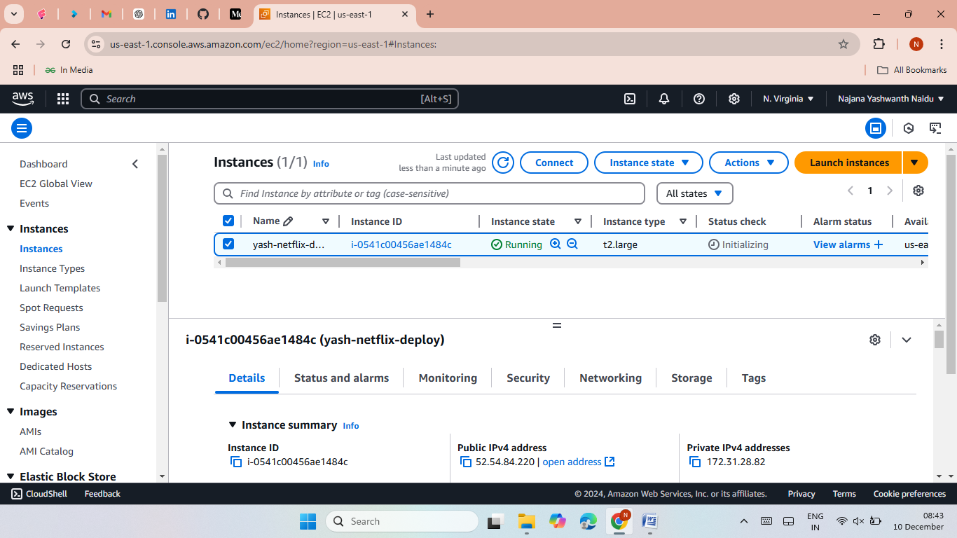
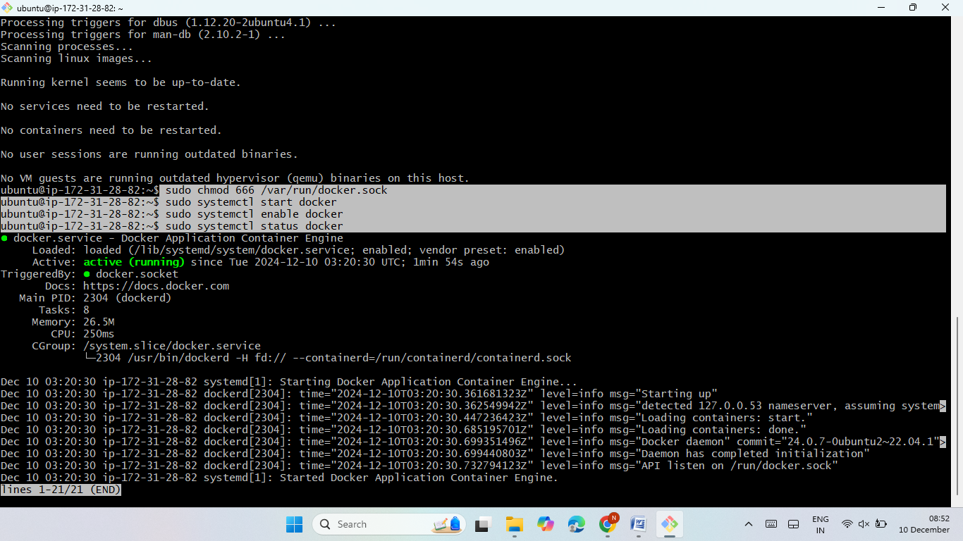
Create TMDB account for API.
Generate API keys and API token.
Now generate new image using API key.
Then generate conatainer then host the Netflix application.

Slide 5
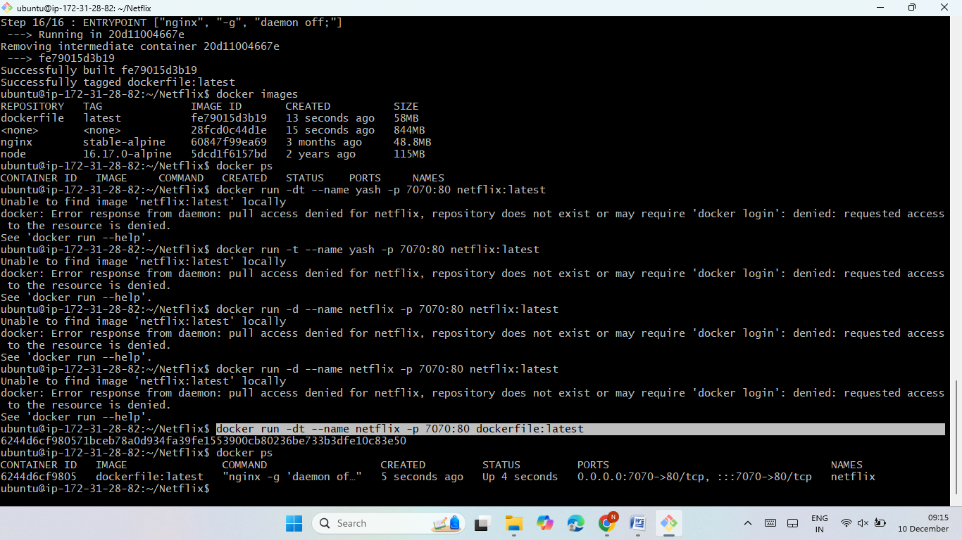
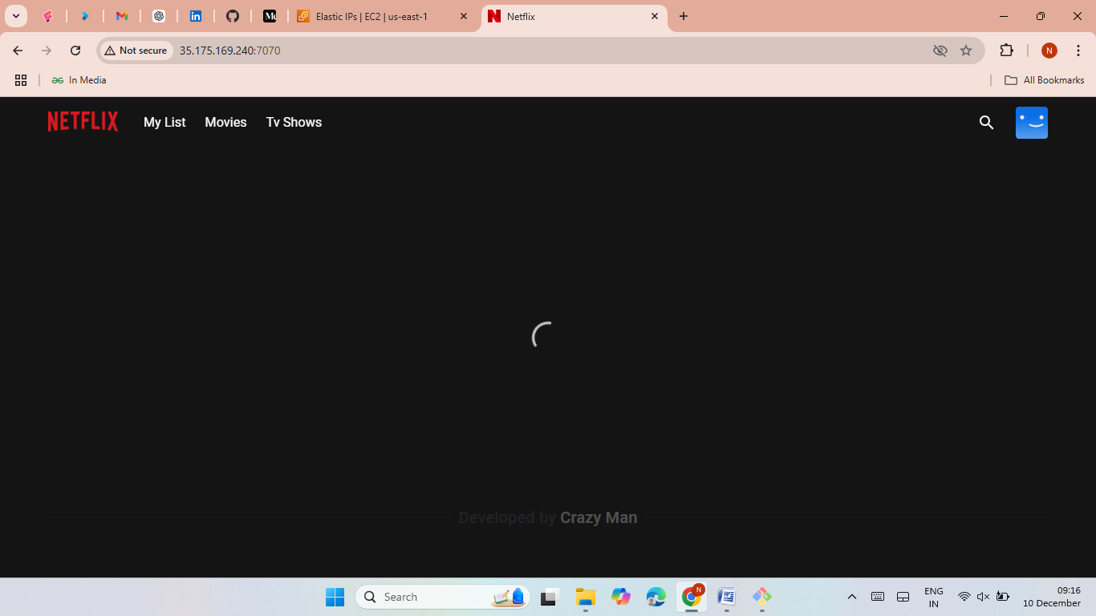
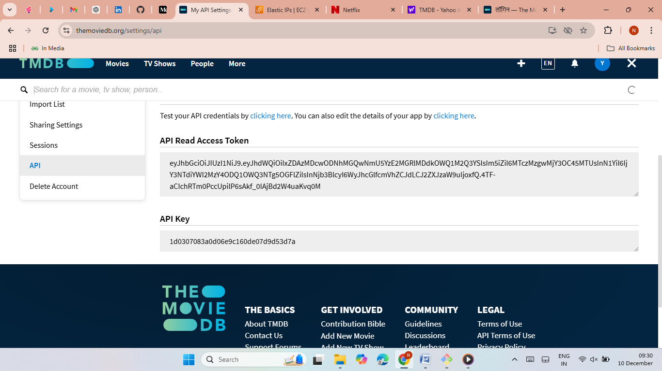
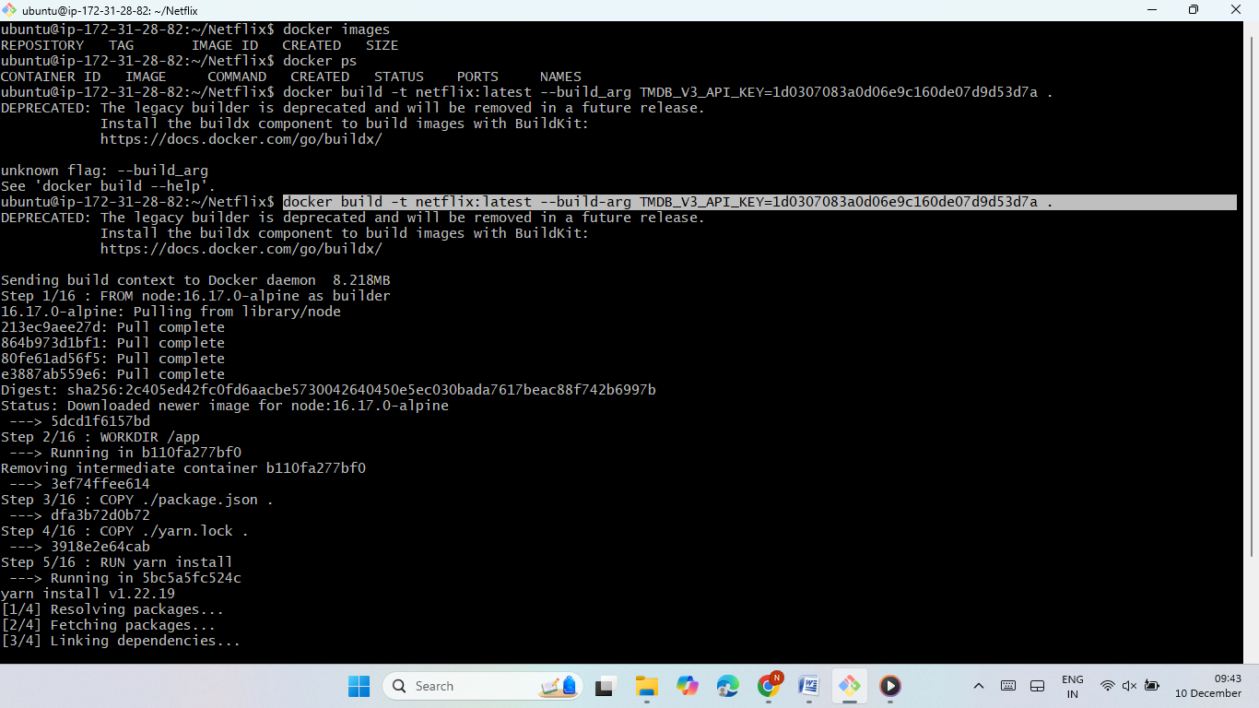
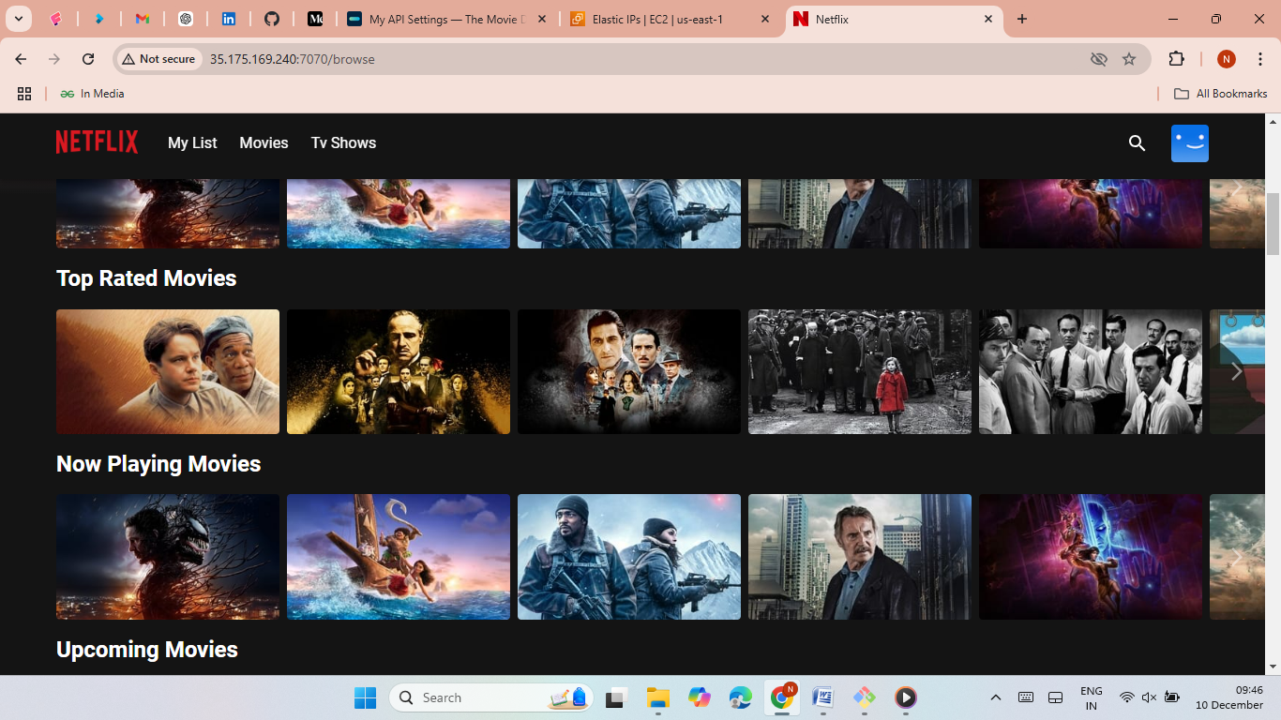
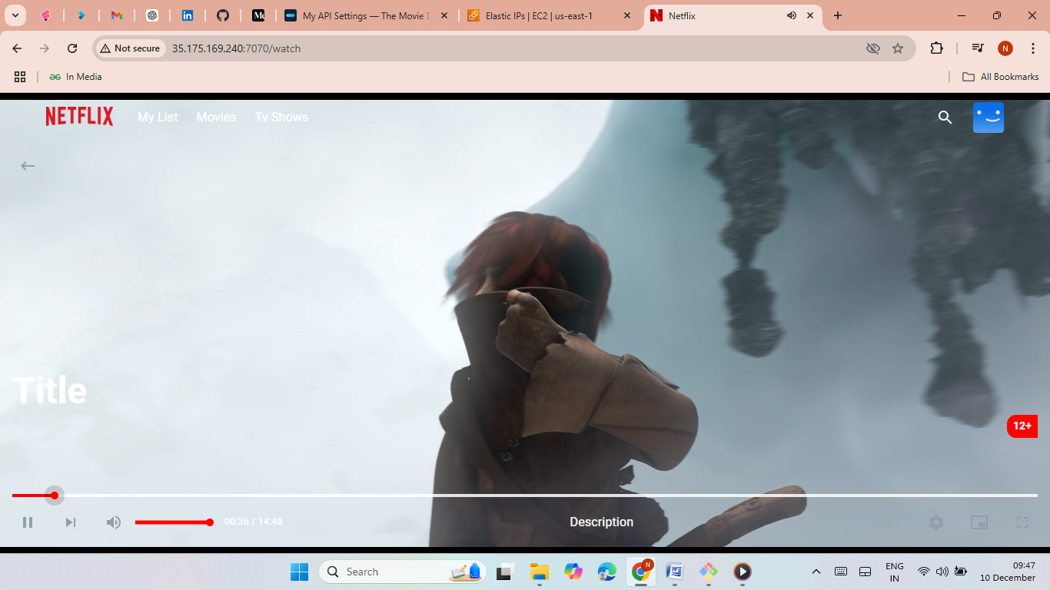

Slide 6
Phase 2: Security Implementation
Tools used:
SonarQube for code quality analysis.
Trivy for vulnerability scanning.
Steps:
Run Docker container for SonarQube and host it on port 9000.
Install and use Trivy to scan Docker images.

Slide 7
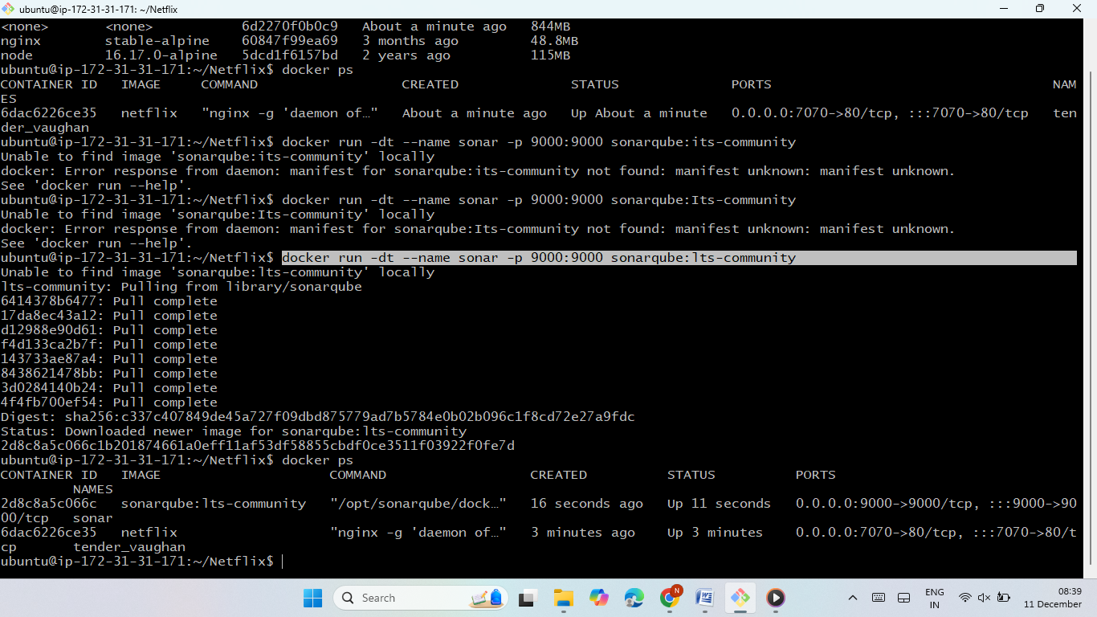
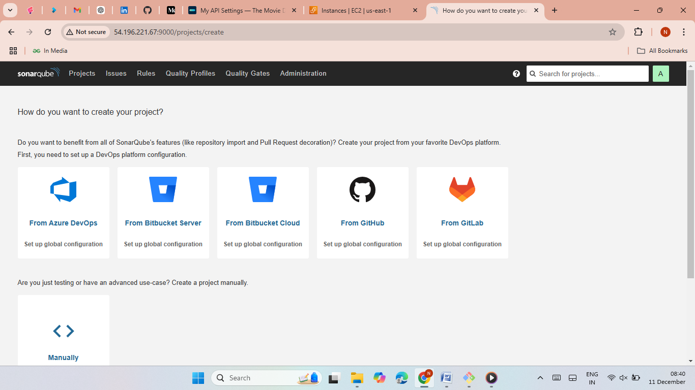
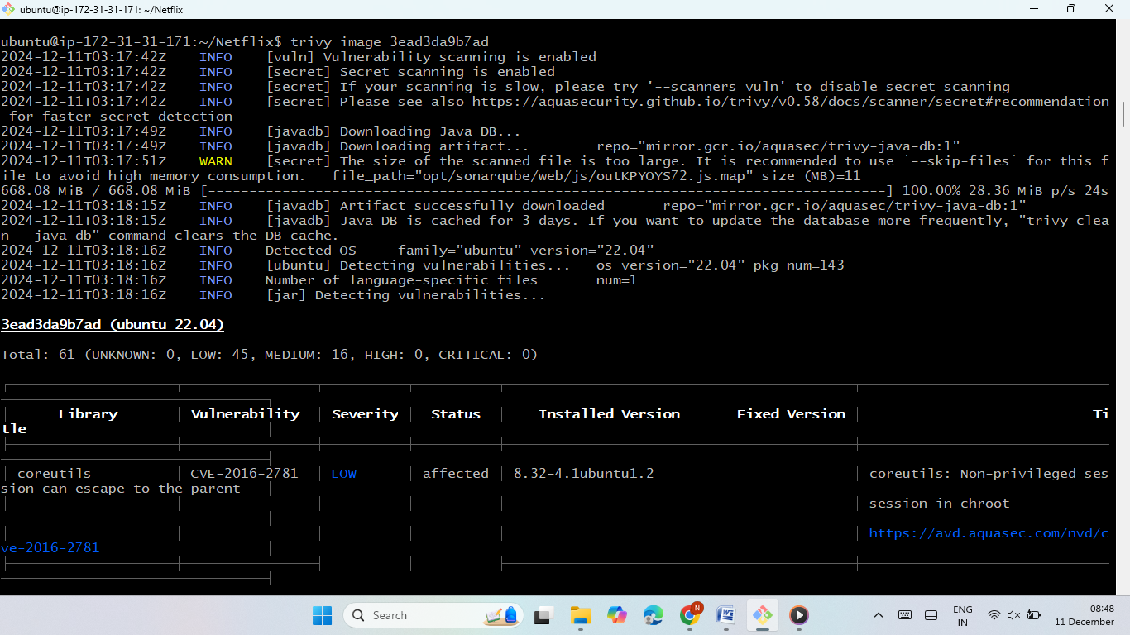
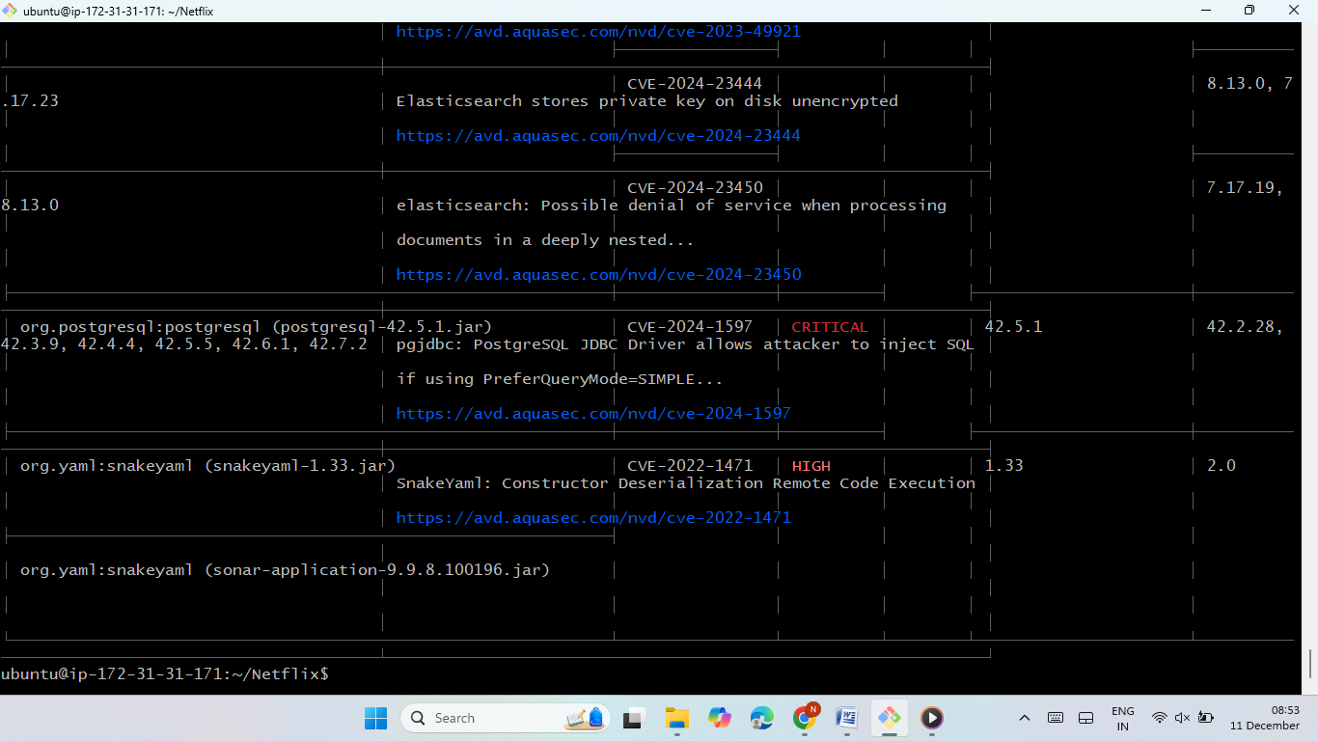

Slide 8
Phase 3: Jenkins Automation
Steps:
Install and configure Jenkins with required plugins.
Create a pipeline script to automate application deployment.
Integrate with SonarQube and Docker.
Use pipeline stages for building, scanning, and deploying the application.

Slide 9
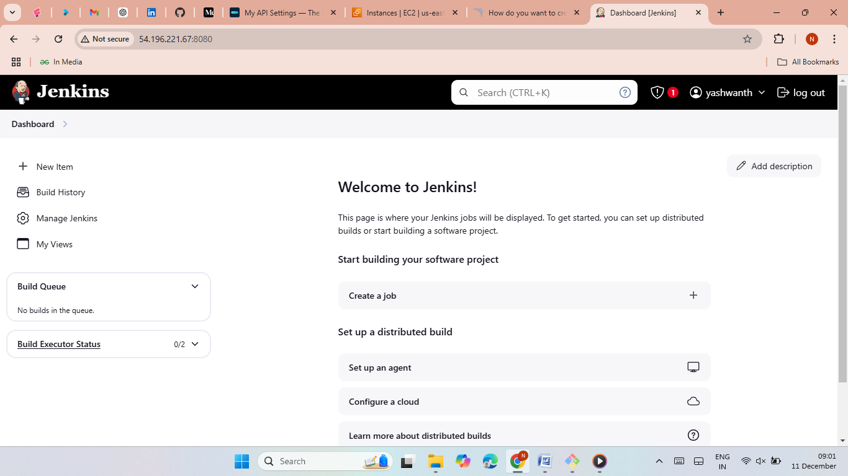
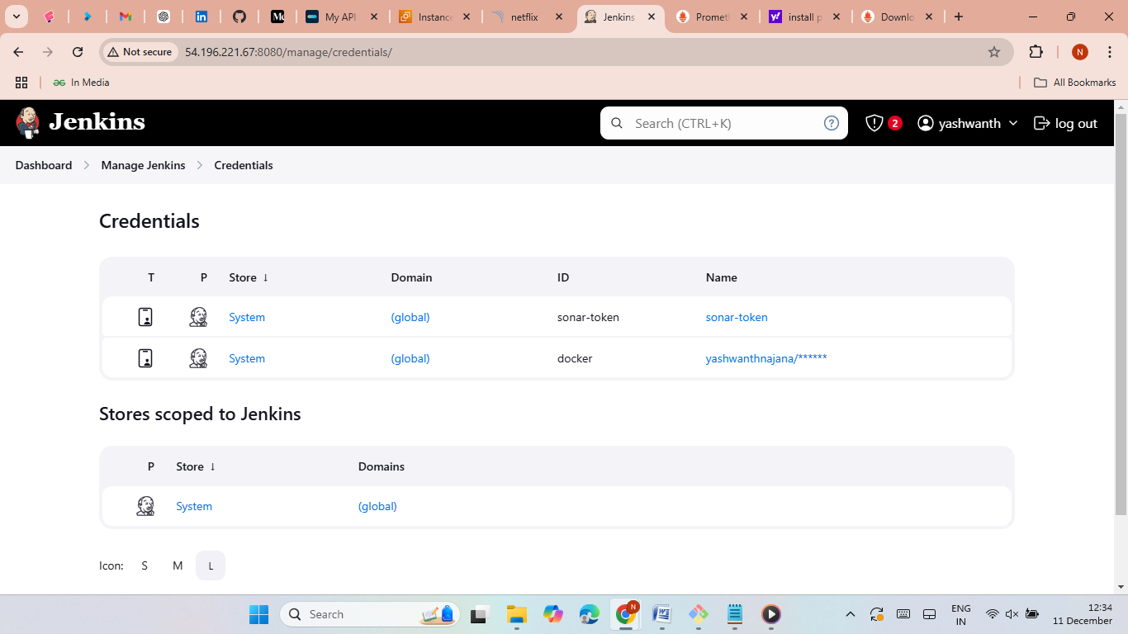
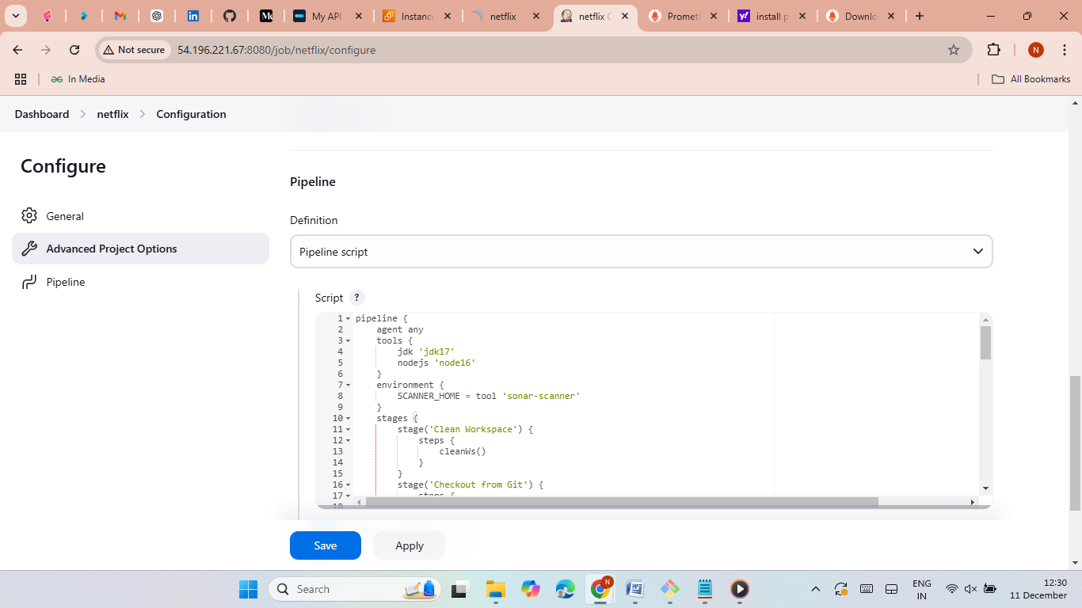
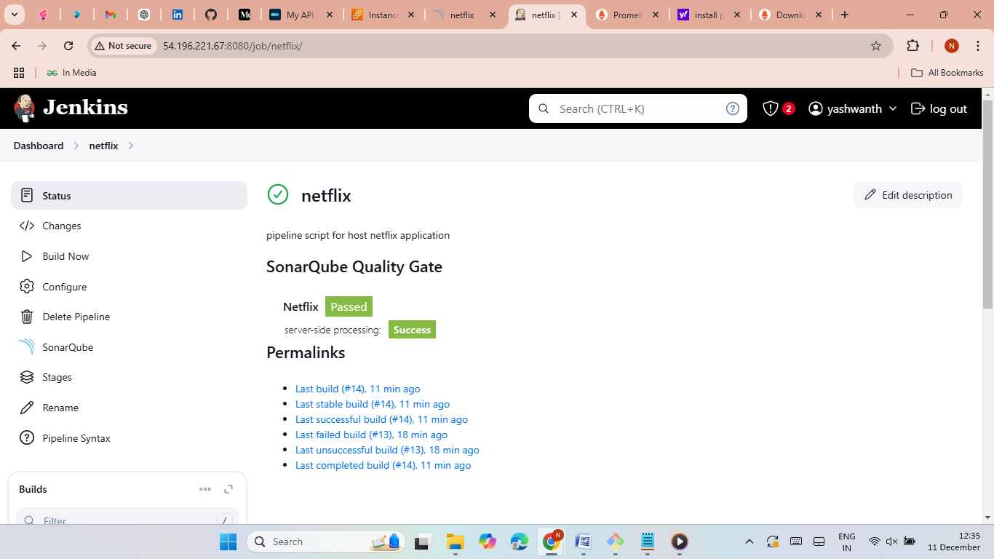
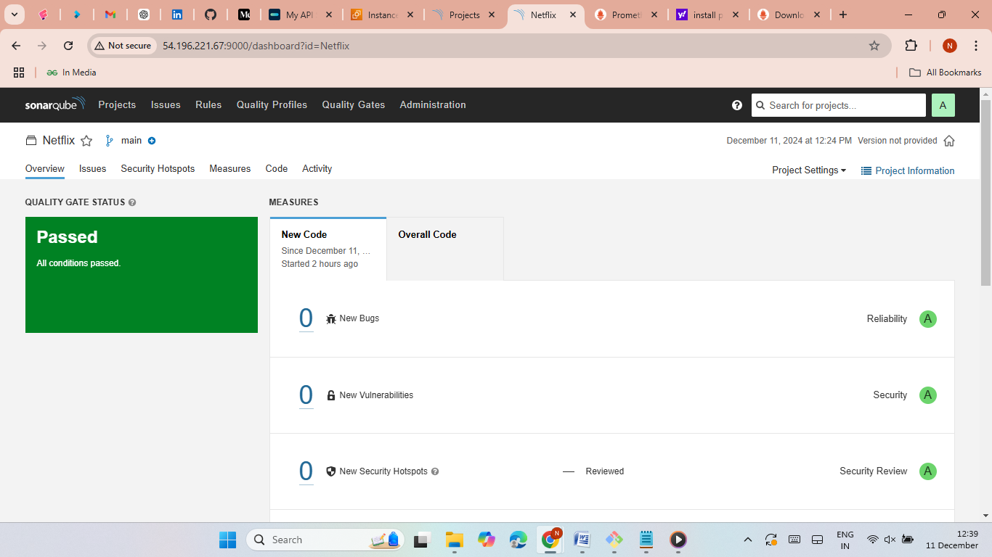


Slide 10
Phase 4: Monitoring with Prometheus and Grafana
Steps:
Set up Prometheus for metrics collection and visualization.
Install Node Exporter for hardware metrics.
Configure Grafana to visualize data from Prometheus.
Monitor Jenkins and application performance.

Slide 11
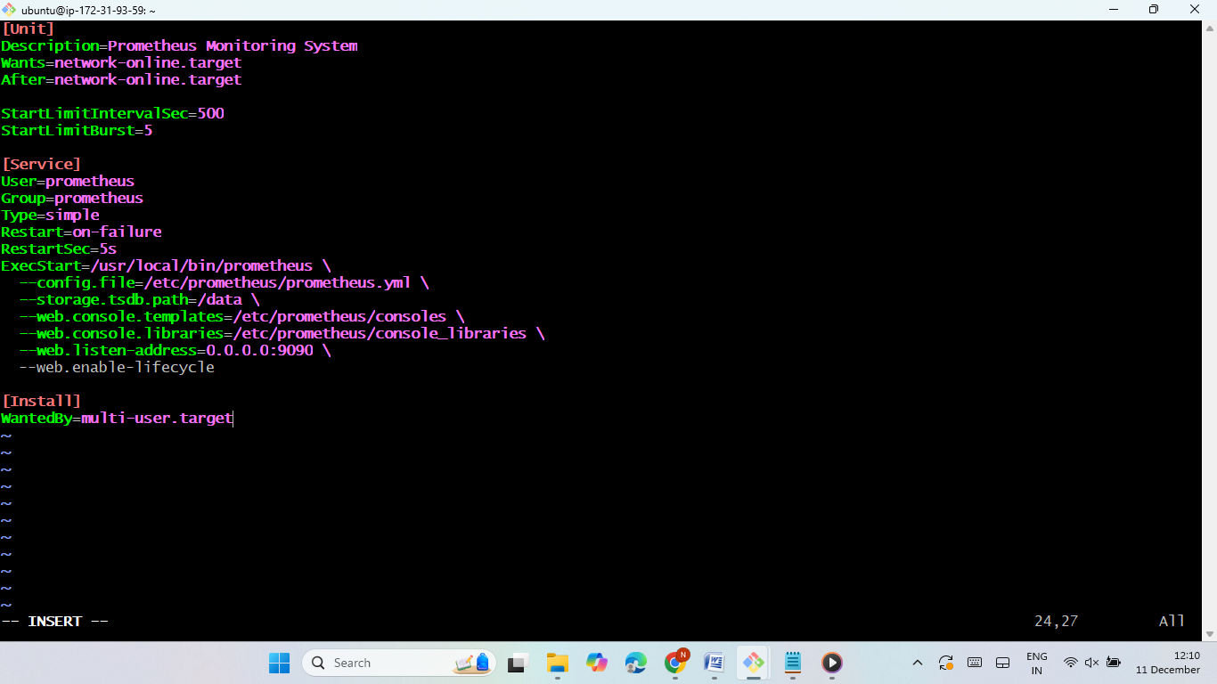
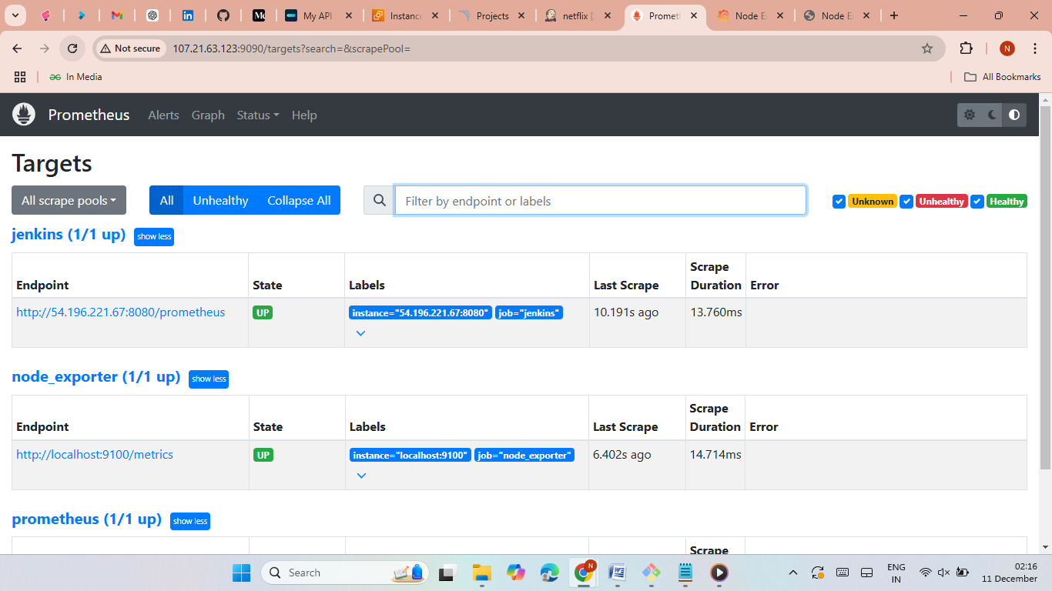
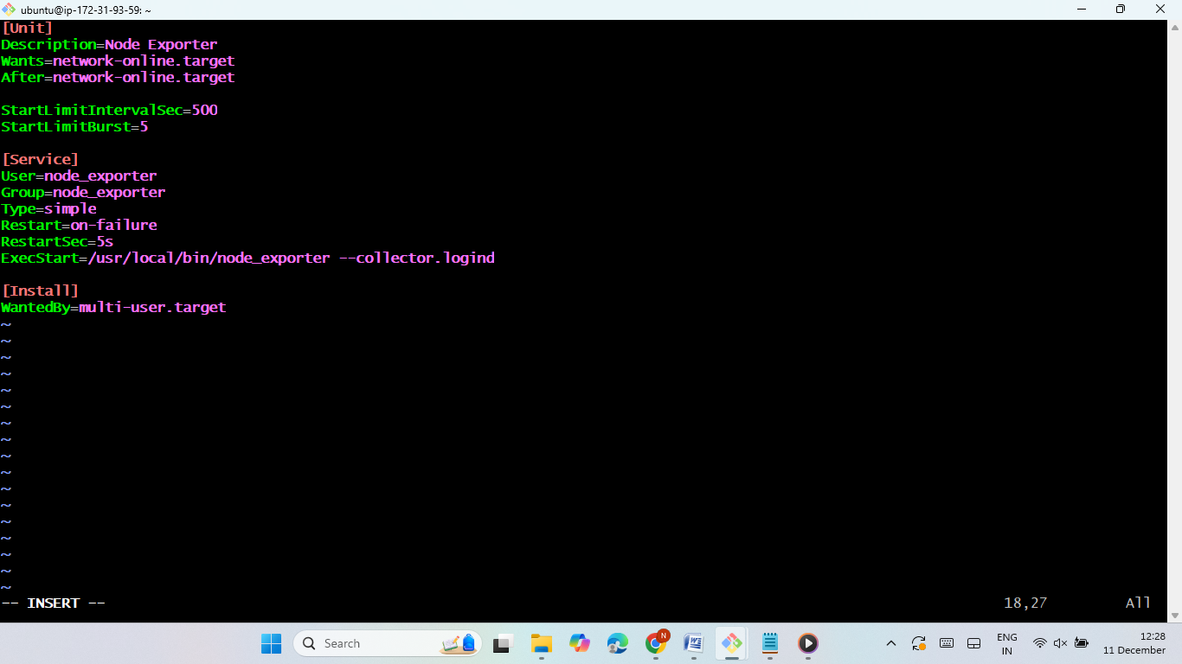
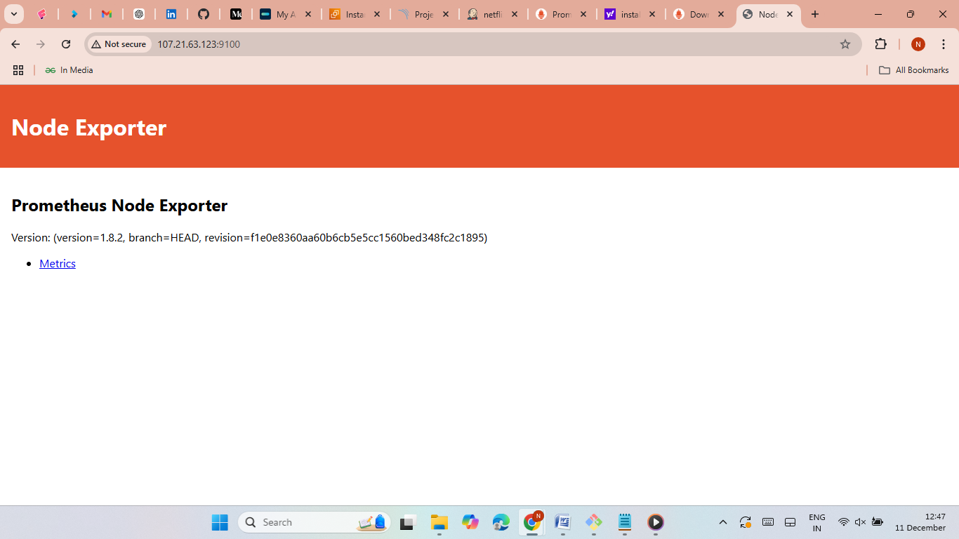
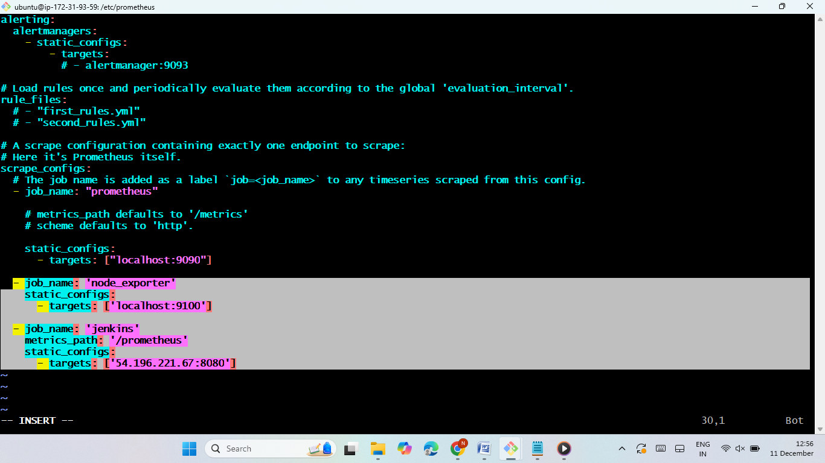
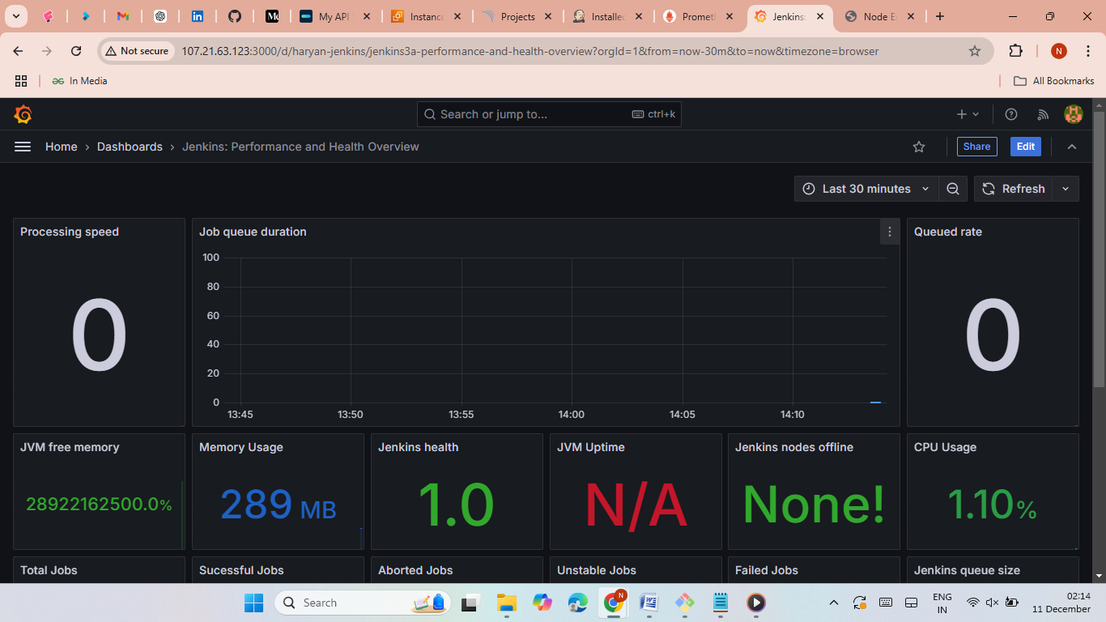

Slide 12
Phase 5: Kubernetes Deployment
Tools used:
Amazon EKS for Kubernetes cluster.
ArgoCD for GitOps-based deployment.
Steps:
Create an EKS cluster and node group.
Install Helm and set up Prometheus Node Exporter.

Slide 13
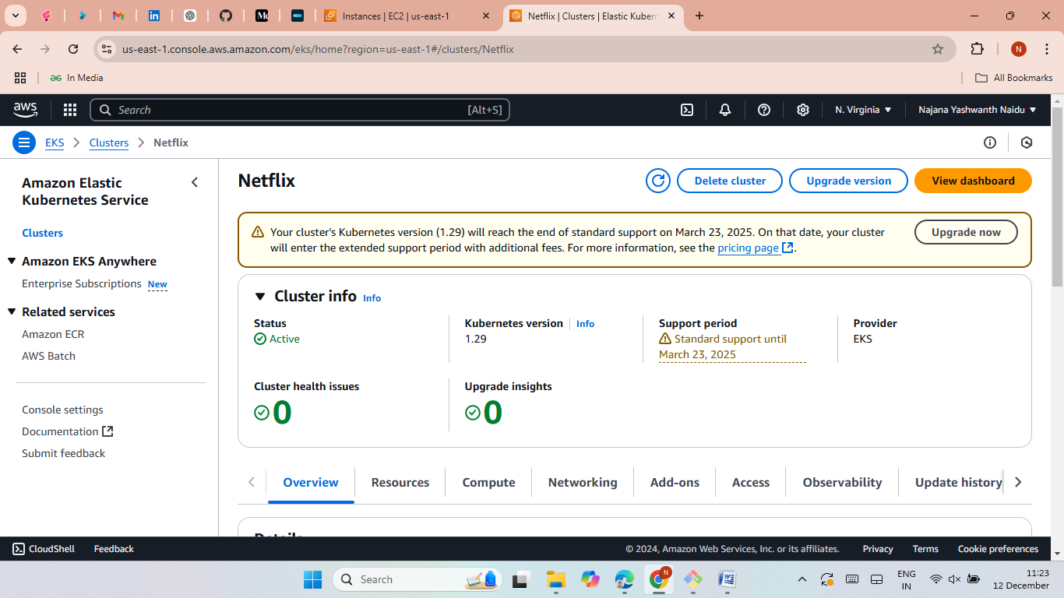
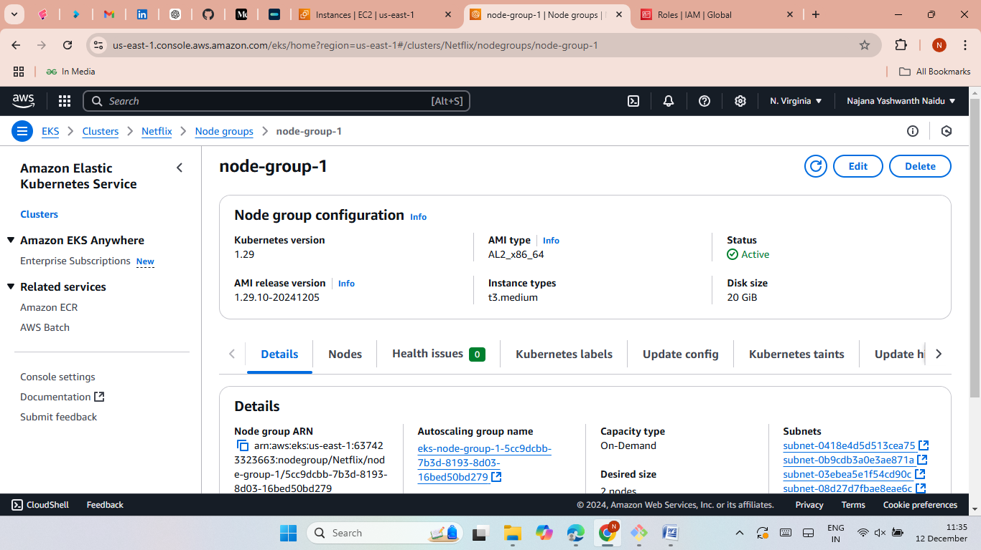
Deploy ArgoCD and configure Git repository.
Deploy and synchronize the Netflix application using ArgoCD.

Slide 14
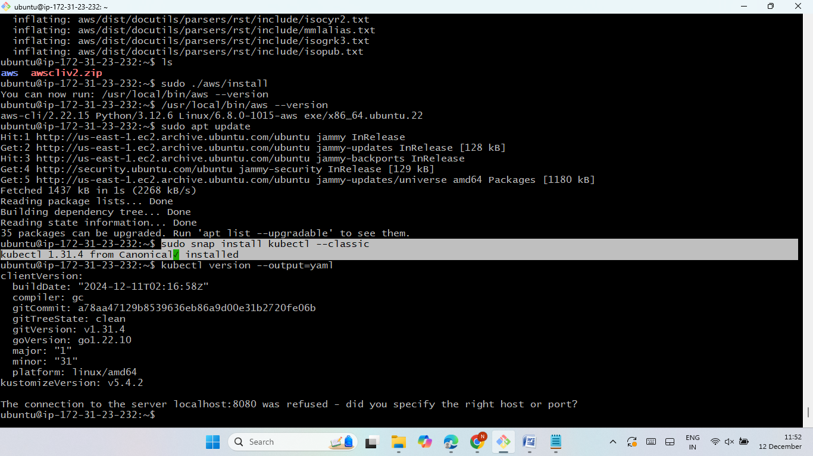
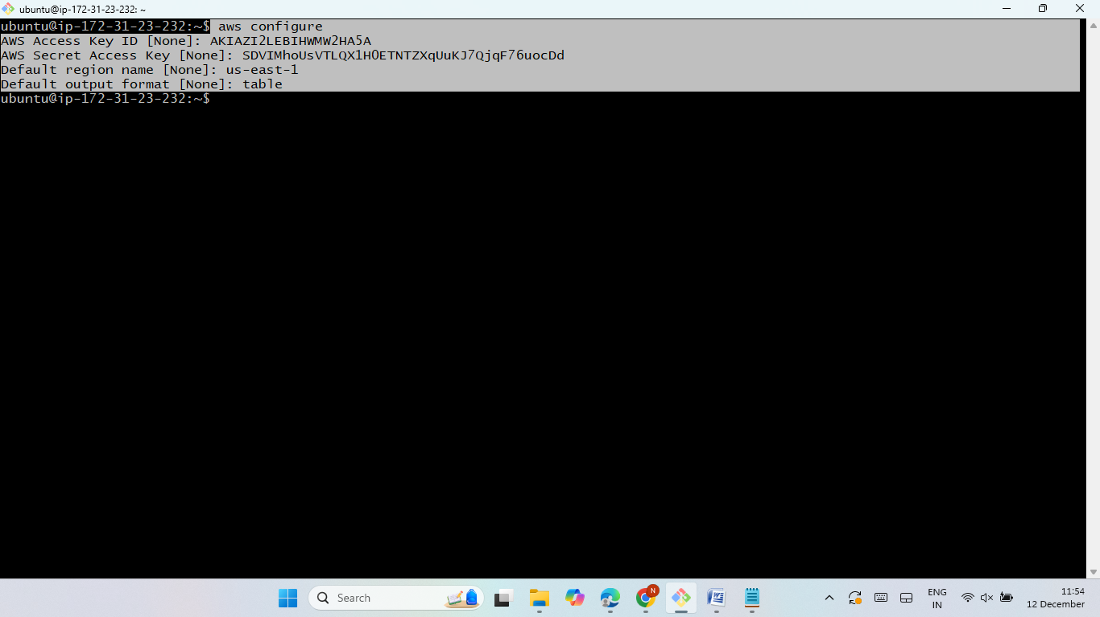
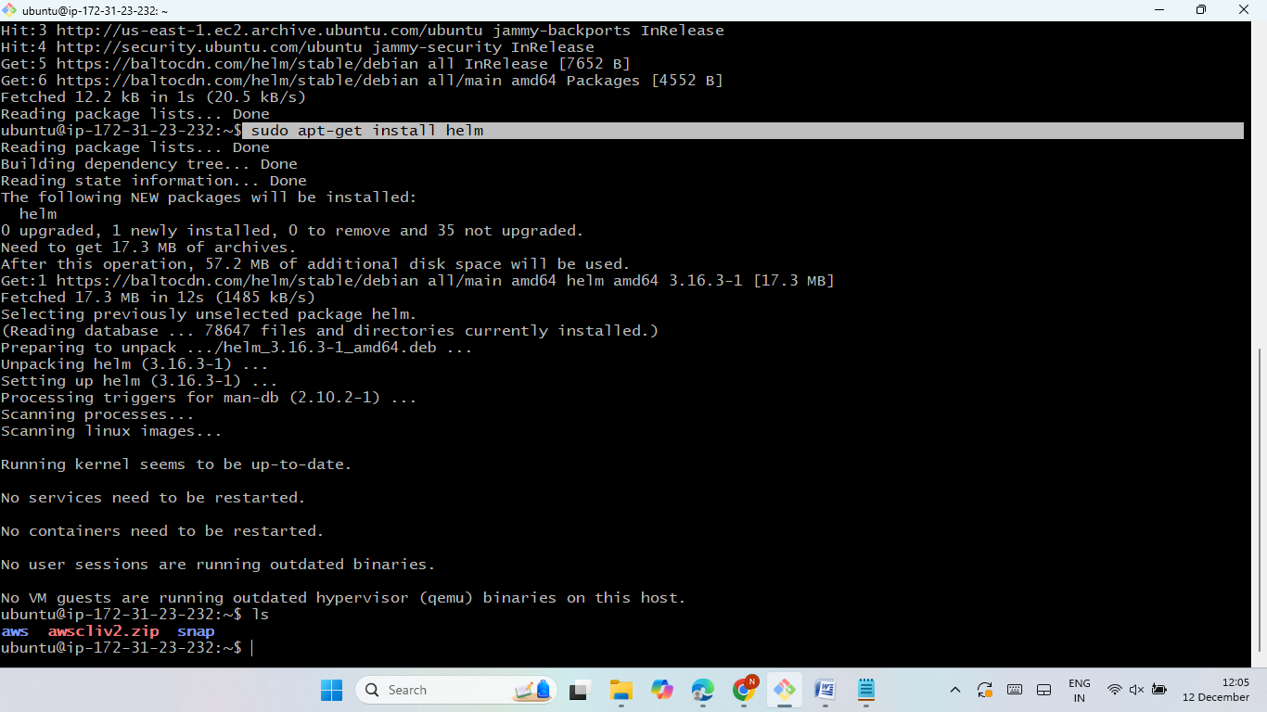
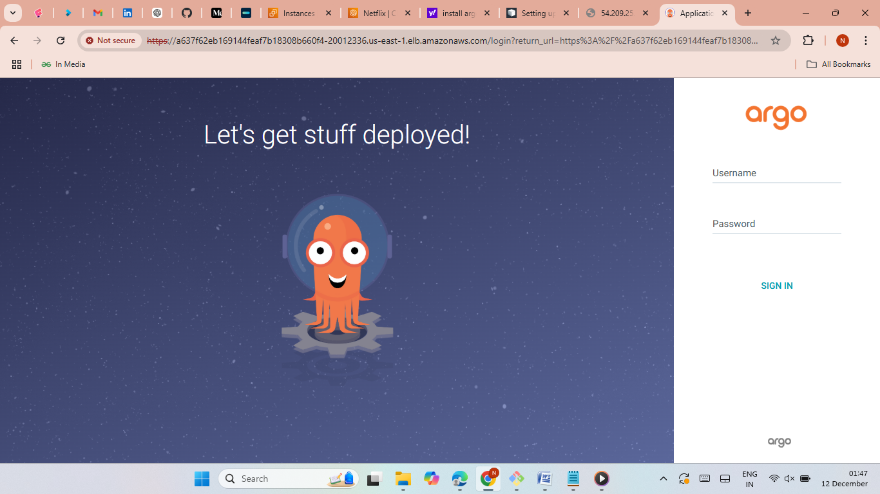
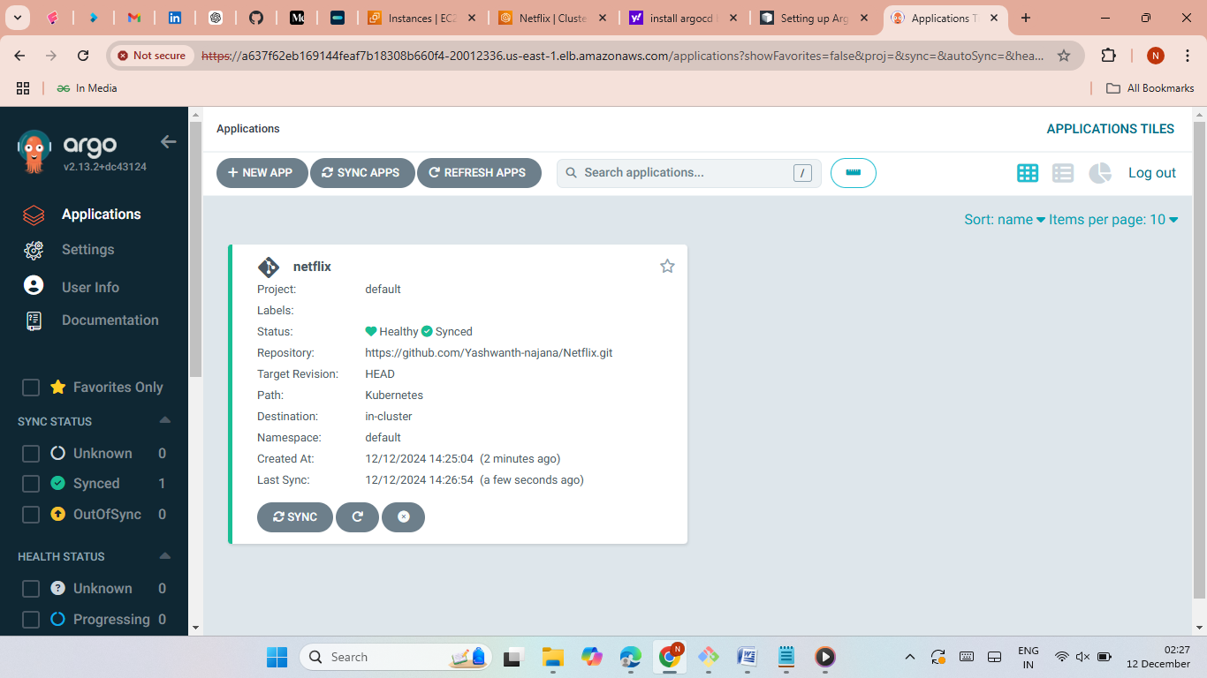
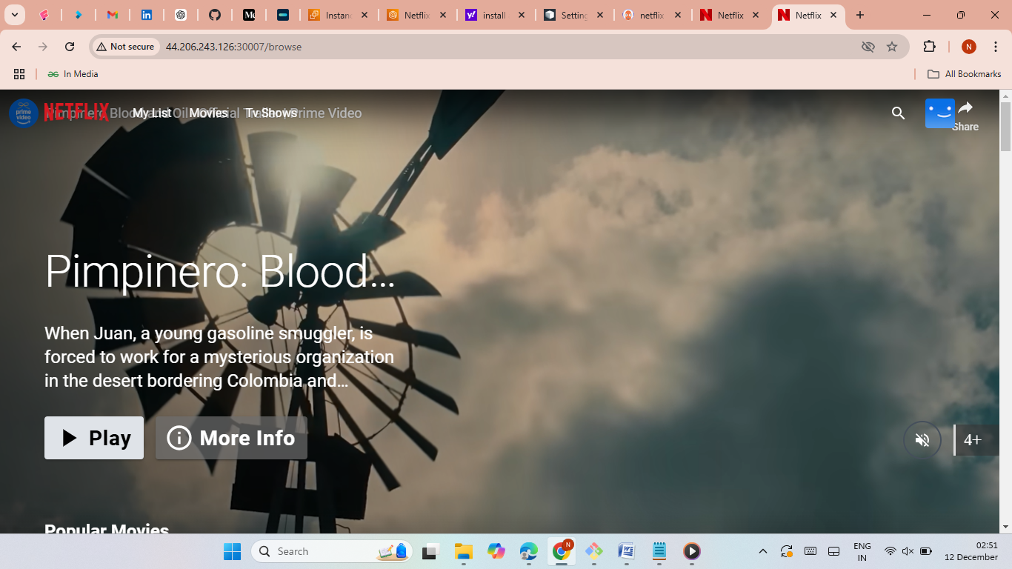

Slide 15
Conclusion
This project demonstrates a comprehensive approach to deploying, securing, automating, and monitoring applications using modern DevOps tools and practices. The final deployment leverages Kubernetes and GitOps for scalability and reliability.

Slide 16
Thank You

